Slide 1
SSDN Project Network Model GUI List of main use cases
Doufene / T. Ishimatsu
MIT/CCES 19Feb2015

Slide 2

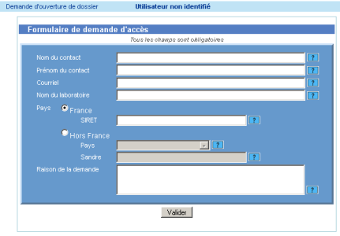
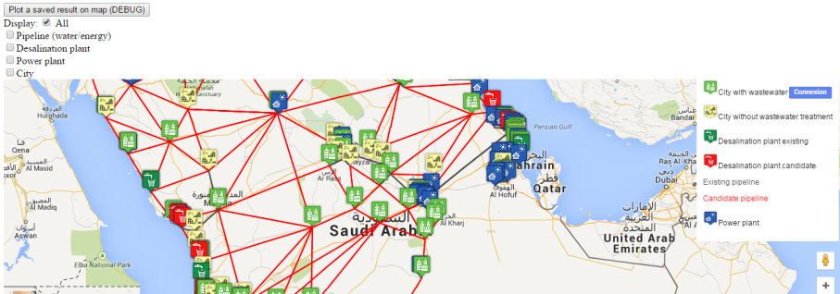
Main Architecture
DATA MANIPULATION Use cases
QUERIES Use cases
Database (Excel Sheet used so far)
Database Buffer (Created to store optimization results)
INFINIT Docker

Slide 3
Data Manipulation Use cases (1/4)
Web Page Water Layer
Add New Desalination Plant
Retire (Delete) Desalination Plant
Modify Desalination Plant attributes
Add New Water Pipeline
Retire (Delete) Water Pipeline
Modify Water Pipeline attributes

Slide 4
Data Manipulation Use cases (2/4)
Web Page Energy Layer
Add New Power Plant
Retire (Delete) Power Plant
Modify Power Plant attributes
Add New Transmission Line
Retire (Delete) Transmission Line
Modify Transmission Line attributes

Slide 5
Data Manipulation Use cases (3/4)
Web Page City Layer
Modify City attributes (population, water demand per capita, etc)

Slide 6
Data Manipulation Use cases (4/4)
Run INFINIT

Slide 7
Queries Use cases
+ Select what to display (Power Plant Only, Desalination Plant only, both, etc.)
+ Display the output parameters Cost/Capex/etc.
+ Display in two windows:
State of the existing Network
State of the Network after optimization
+ Display the attributes for each entity (see for example http://dwtest.meteor.com/ )

